Slide 1

Database Processing: Fundamentals, Design, and Implementation
15th Edition
Week #11
Database Design Using Normalization

Slide 2
First Normal Form (1NF)
Since all rows must be unique, 1NF is defined as:
Meets the set of conditions for a relation
Has a defined primary key

Slide 3
Second Normal Form (2NF)
A relation is in 2NF if, and only if, it is in 1NF and all non-key attributes are determined by the entire primary key. This is also know as a Partial Dependency.
For example:
A relation R(A, B, N, O, P) with the composite key (A,B) means that none of the non-key attributes N, O, or P can be determined by just A or just B.
(StudentID, Activity) → ActivityFee (True)
Activity → ActivityFee (False)

Slide 4
Third Normal Form (3NF)
A relation is in 3NF if, and only if, it is in 2NF and there are no non-key attributes determined by another non-key attribute. This is also known as a Transitive Dependency.
For example:
A relation R(A, B, N, O, P) with the composite key (A,B) means that none of the non-key attributes N, O, or P can be determined by N, O, or P.
STUDENT_HOUSING (StudentID, Building, BuildingFee)
Building → BuildingFee (False)

Slide 5
Boyce-Codd Normal Form (BCNF)
A relation is in BCNF if, and only if, it is in 3NF and every determinant is a candidate key.

Slide 6
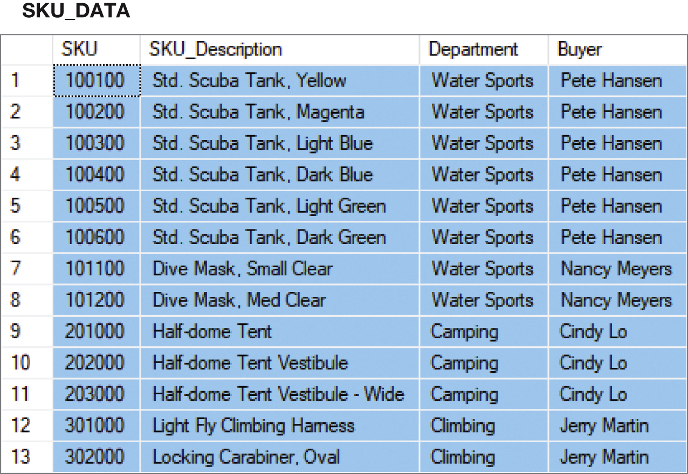
Putting the SKU_DATA Table into BCNF (Step-by-Step) - 1NF
SKU_DATA (SKU, SKU_Description, Department, Buyer)
1NF – Checking against 1NF, this relation is in 1NF.
- The table is a relation and has a primary key

Slide 7
Putting the SKU_DATA Table into BCNF (Step-by-Step) - 2NF
SKU_DATA (SKU, SKU_Description, Department, Buyer)
SKU → (SKU_Description, Department, Buyer)
SKU_Description → (SKU, Department, Buyer)
Buyer → Department
SKU and SKU_Description are candidate keys.
A relation is in 2NF if, and only if, it is in 1NF and all non-key attributes are determined by the primary key.
Since SKU is a single column primary key, all non-key attributes are determined by SKU, and the relation is in 2NF.
SKU_Description would be an alternate key

Slide 8
Putting the SKU_DATA Table into BCNF (Step-by-Step) - 3NF (1 of 2)
SKU_DATA (SKU, SKU_Description, Department, Buyer)
SKU → (SKU_Description, Department, Buyer)
SKU_Description → (SKU, Department, Buyer)
Buyer → Department
SKU and SKU_Description are candidate keys.
A relation is in 3NF if, and only if, it is in 2NF and there are no non-key attributes determined by another non-key attribute.
However, the term non-key attribute means an attribute that is neither (1) a candidate key itself, nor (2) part of a composite candidate key.
Therefore, the only non key attribute is Buyer, and it is a determinant of Department.
Therefore, this is not in 3NF.

Slide 9
Putting the SKU_DATA Table into BCNF (Step-by-Step) - 3NF (2 of 2)
Therefore, break out the Buyer → Department functional dependency.
SKU_DATA_2 (SKU, SKU_Description, Buyer)
BUYER (Buyer, Department)
Where SKU_DATA_2.Buyer must exist in BUYER.Buyer
SKU_DATA_2 is in 3NF
BUYER is in 3NF

Slide 10
Putting the SKU_DATA Table into BCNF (Step-by-Step) - BCNF
SKU_DATA_2 (SKU, SKU_Description, Buyer)
BUYER (Buyer, Department)
Where SKU_DATA_2.Buyer must exist in BUYER.Buyer
SKU → (SKU_Description, Department, Buyer)
SKU_Description → (SKU, Department, Buyer)
Buyer → Department
A relation is in BCNF if, and only if, it is in 3NF and every determinant is a candidate key.
In SKU_DATA_2, both determinants are determinant keys, so SKU_DATA_2 is in BCNF
In BUYER, the determinant is a determinate key, so BUYER is in BCNF.

Slide 11
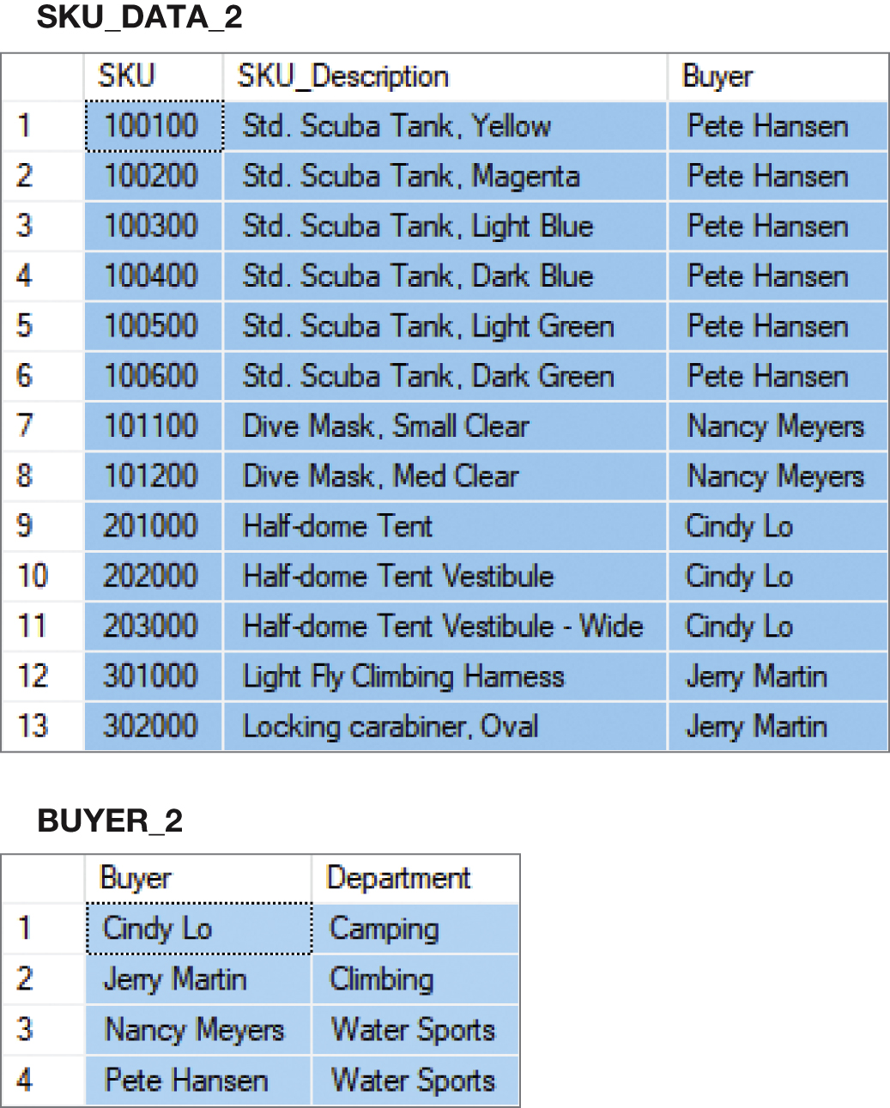
The Results of the Step-by-Step to BCNF

Slide 12
Advantages and Disadvantages of Normalization
Advantages and Disadvantages of Normalization
Advantages
Eliminate modification anomalies
Reduce duplicated data
Eliminate data integrity problems
Save file space
Single table queries will run faster
Disadvantages
More complicated SQL required for multitable subqueries and joins
Extra work for DBMS can mean slower applications

Slide 13
Multivalued Dependencies
Anomalies from multivalued dependencies are very problematic.
Always place the columns of a multivalued dependency into a separate table (4NF).

Slide 14
Denormalization
For read-only databases, normalization is seldom an advantage.
Application processing speed is more important.
Denormalization is the joining of the data in normalized tables prior to storing the data.
The data is then stored in nonnormalized tables.

Slide 15
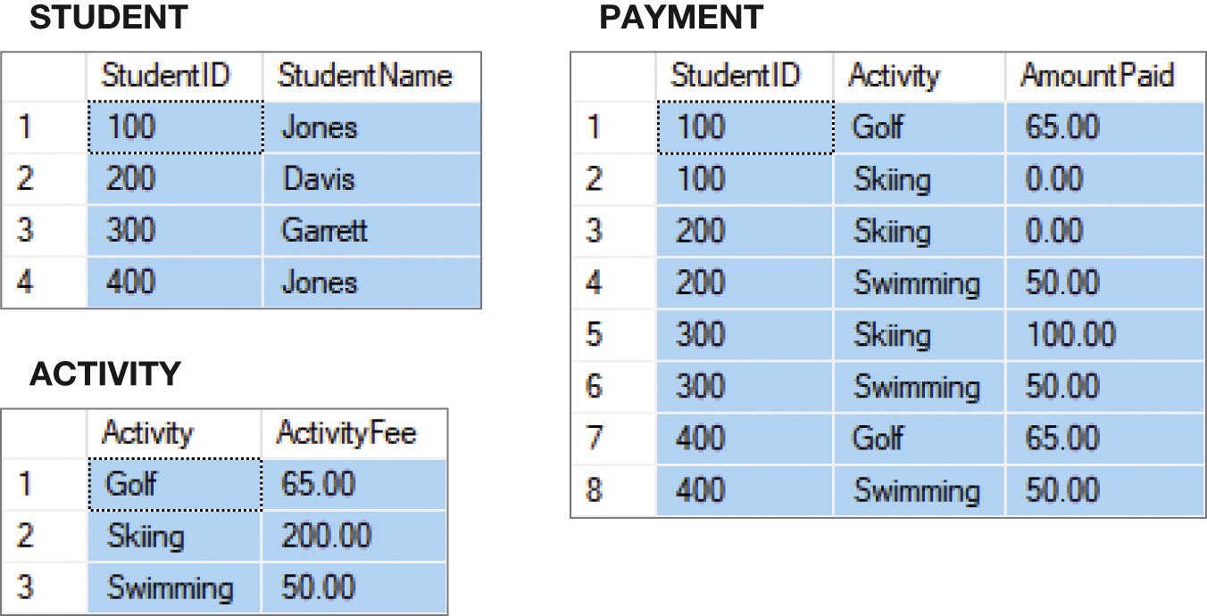
Normalized Relations

Slide 16
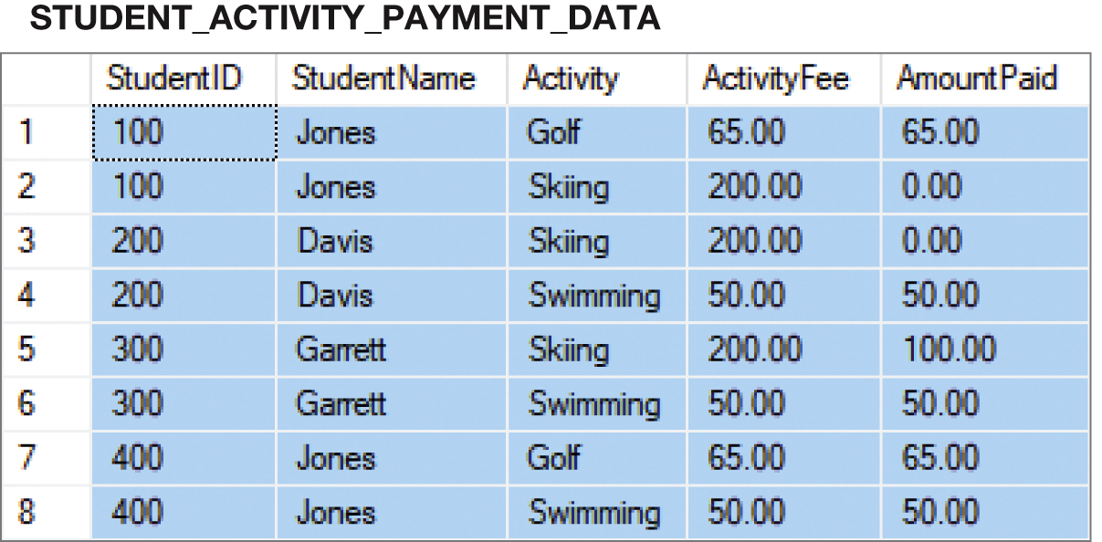
Denormalizing the Data
INSERT INTO STUDENT_ACTIVITY_PAYMENT_DATA
SELECT STUDENT.StudentID, StudentName, ACTIVITY.Activity, ActivityFee, AmountPaid
FROM STUDENT, PAYMENT, ACTIVITY
WHERE STUDENT.StudentID = PAYMENT.StudentID
AND PAYMENT.Activity = ACTIVITY.Activity;

Slide 17
Customized Tables
Read-only databases are often designed with many copies of the same data, but with each copy customized for a specific application.

Slide 18
Common Design Problems
Practical Problems in Designing Databases from Existing Data
The multivalue, multicolumn problem
Inconsistent values
Missing Values
General-purpose remarks column

Slide 19
The Multivalue, Multicolumn Problem
The multivalue, multicolumn problem occurs when multiple values of an attribute are stored in more than one column:
EMPLOYEE (EmployeeNumber, EmployeeLastName, EmployeeFirstName, EmailAddress, Auto1_Li enseNumber, Auto2_LicenseNumber, Auto3_LicenseNumber)
The solution is to use a separate table to store the multiple values.

Slide 20
Inconsistent Values
Inconsistent values occur when different users or different data sources use slightly different forms of the same data value:
Different codings:
SKU_Description = 'Corn, Large Can'
SKU_Description = 'Can, Corn, Large'
SKU_Description = 'Large Can Corn‘
Different spellings:
Coffee, Cofee, Coffeee

Slide 21
Missing Values
A missing value or null value is a value that has never been provided.
In a database table, a null value appears in upper case letters as NULL.

Slide 22
Null Values
Null values are ambiguous:
May indicate that a value is inappropriate
DateOfLastChildbirth is inappropriate for a male
May indicate that a value is appropriate but unknown
DateOfLastChildbirth is appropriate for a female, but may be unknown
May indicate that a value is appropriate and known, but has never been entered
DateOfLastChildbirth is appropriate for a female, and may be known but no one has recorded it in the database

Slide 23
The General-Purpose Remarks Column
A general-purpose remarks column is a column with a name such as:
Remarks
Comments
Notes
It often contains important data stored in an inconsistent, verbal, and verbose way
A typical use is to store data on a customer’s interests
Such a column may:
Be used inconsistently
Hold multiple data items

Slide 24
Database Processing Fundamentals, Design, and Implementation (15th Edition)
End of Presentation:
Week #11

